Slide 1
Adaptation for
Mobile Data Access
(DM1 & PL1)

Slide 2
Outline
Motivation
Models of Adaptation
Application-transparent Adaptation
  Design and implementation
  Evaluation
Application-aware Adaptation
  Design and implementation
  Evaluation
Conclusion and Future Work

Slide 3
Motivation
Constraints of mobility
  Lack of local resources and the physical security reliance on server
  Variable network connectivity in bandwidth, latency, reliability, and cost reliance on client
Mobility needs adaptive system to meet the intrinsic constraints.

Slide 4
Models of Adaptation
Who is responsible for adaptation?
  Individual applications (laissez-faire adaptation)
  The system (application-transparent adaptation)
    system provides resource arbitration.
    existing applications continue to work even when mobile.
  Both (application-aware adaptation)
    application specific information is used while the system controls resources.

Slide 5
Application-aware
(ex. Odyssey)
Laissez-faire
Application-transparent
(ex. Eudora)
(ex. Coda)

Slide 6
Application-transparent Adaptation (Coda)
Application
To Coda
Servers
Venus
(Cache Manager)
System Call Interface
Vnode Interface
Coda Mini Cache

Slide 7
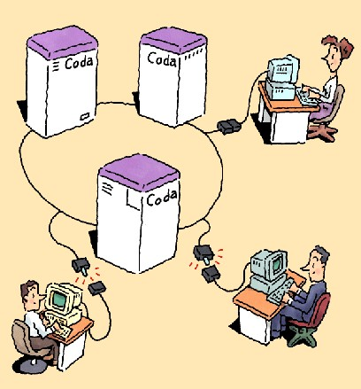
Illustration by Gaich Muramatsu

Slide 8
Design and Implementation
Goal: high availability
  Disconnected operation
    while disconnected, Venus serves file system requests.
    when disconnection ends, Venus propagates modifications.
  Server replication
    allows volumes to have replicas at more than one server.

Slide 9
Design rationale
Scalability
  callback-based cache coherence
    servers notifies clients when their cached copies are no longer valid.
  whole-file caching
    when Venus fetches a file, it fetches the entire file from the servers.
    cache misses can occur only when files are open.

Slide 10
Design rationale
Advent of portable workstation
  disconnection
Optimistic replica control
  when a client is disconnected, the system permits reads and writes everywhere.
  treats conflicts after their occurrence.
  provides higher availability.

Slide 11
Ex. cat /coda/usr/jjk/foo
open call is forwarded by the Vnode interface.
When it is realized that the request is for a file in the /coda file system, it is handed to the Coda MiniCache in the kernel.
When the MiniCache does not have usr/jjk/foo, the request is passed to Venus and Venus checks the client disk cache for usr/jjk/foo and in case of a cache miss, it contacts the servers to ask usr/jjk/foo.
Venus enters a disconnected mode, when there is no network connection to any server.

Slide 12
Venus states and transitions
Hoarding
disconnection
local reconnection
Emulation
physical reconnection
Reintegration

Slide 13
Hoarding
Why?
  Venus cannot serve a cache miss during a disconnection. important files should be kept in the cache up to date.
Prioritized cache management
  Users may give information on priority of files (HDB).
  Recent reference history and HDB are used for hoarding.
Hoard walking
  updates the hoarded files.

Slide 14
Hoarding
Hoard profiles
# Personal files
a /coda/usr/jjk d+
a /coda/usr/jjk/papers 100:d+
a /coda/usr/jjk/papers/sosp 1000:d+
# System files
a /usr/bin 100:d+
a /usr/etc 100:d+
a /usr/lib 100:d+

Slide 15
Hoard walking
Goal: to meet equilibrium.
  Cache is in equilibrium when no uncached file has a higher priority than a cached file.
  Every 10 minutes or by users request.
Phase 1
  Name bindings of HDB entries are re-evaluated.
Phase 2
  Priorities in the cache and HDB are re-evaluated.

Slide 16
Emulation
Venus takes the role of pseudo-server.
Logging
  records information for reintegration in a replay log.
    logs a store record rather than logging the every open, close, and intervening write operation.
    Discards a previous store record when a new one for the same file is appended to the log.
Persistence
  cached directory, replay logs, and the HDB is stored in nonvolatile storage.

Slide 17
Reintegration
Venus propagates changes made during emulation and updates its cache. All activity is suspended till completion of reintegration.
Replay algorithm
  Clients
    Venus obtains permanent file ids for new files.
    Venus transfers the replay log to the servers.
  Servers
    parses the log and all files referenced in the log are locked. Transaction begins.
    validates each object in the log and executes it.
    transfers data.
    commits the transaction and releases all locks.

Slide 18
Reintegration
Conflict handling
  During phase two of replay, a server compares the unique storid associated with that in a log entry.
  If there is a conflict the entire reintegration is aborted.
    Ex:
      conflict in the case of a store of file
      creating a new directory: conflicts occur if the name collides with an exiting name.
      modification of attributes
  Venus stores all replay information in its local disk when reintegration fails, and users can selectively replay it manually.

Slide 19
Evaluation
Duration of reintegration
  time to allocate permanent fids +
  time for the replay at the servers +
  time for server replication
Cache size
Likelihood of conflicts

Slide 20
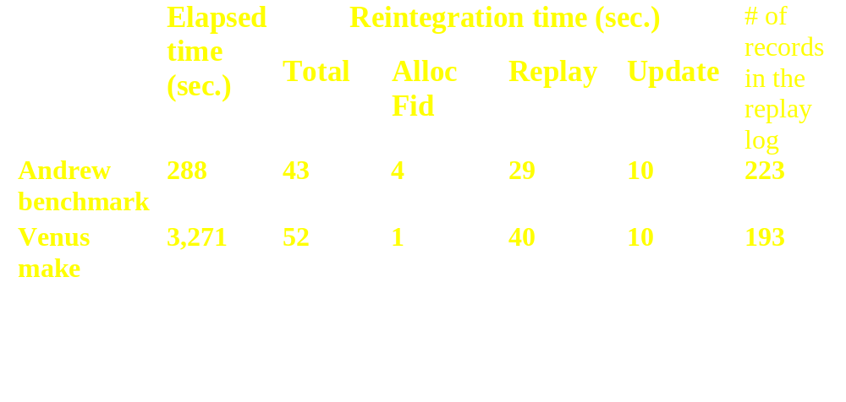
Time for reintegration

Slide 21
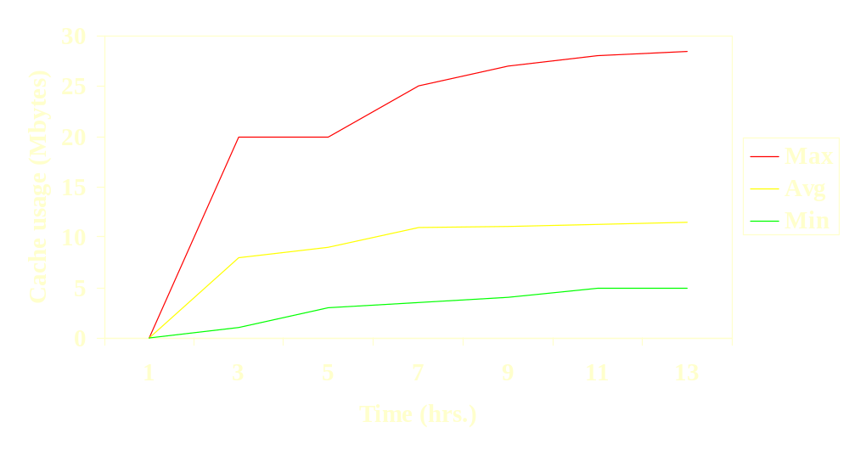
Cache size

Slide 22
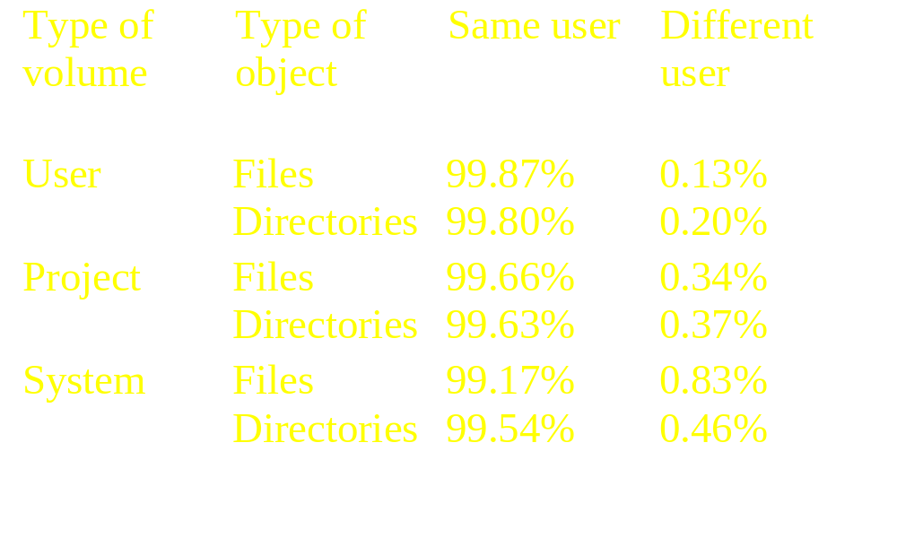
Likelihood of conflicts

Slide 23
Summary
Coda can support disconnect operation.
  Ex: 100MB local disk, 50MB cache, one or two day disconnection
  about 1 minute reintegration

Slide 24
Application-aware Adaptation
(Odyssey)
Application
Warden1
Warden2
Wardon3
Viceroy
Odyssey API extension

Slide 25
Design and implementation
Goal: Collaborative partnership between the operating system and applications
  Adaptation is the key to mobility.
    unpredictable variation in network quality
    disparity in the availability of remote services
    limitations on local resources
  Odyssey monitors resources, interacts with each application, and applications decide the best adaptation when notified.

Slide 26
Design rationale
Fidelity
  Degree to which data presented at a client matches the reference copy at the server.
    video data: frame rate and image quality
    telemetry data: sampling rate and timeliness
Concurrency
  Ability to execute multiple independent applications concurrently on a mobile client.
Agility
  Speed and accuracy with which it detects and responds to changes in resource availability
    The larger change is, the more important the agility is.

Slide 27
Viceroy and wardens
Viceroy
  Centralized resource management
    monitoring the availability of resources
    notifying applications of changes
Wardens
  Type-specific operations to change the fidelity
  Responsible for communicating servers and caching data

Slide 28
Expressing resource expectation
Generic resources in Odyssey
  network bandwidth, network latency, disk cache space, CPU, battery power
Resource negotiation operations
  request (in path, in resource-descriptor, out request-id)
  cancel (in request-id)
  resource descriptor
    resource-id, lower bound, upper bound, name of upcall handler
Upcall handler
  handler (in request-id, in resource-id, in resource-level)
TSO (Type-Specific Operations)
  tsop (in path, in opcode, in insize, in inbuf, inout outsize, out outbuf)

Slide 29
Notifying applications
Viceroy generates an upcall to the corresponding application
Application adjusts its fidelity according to its policy with the resource-level.

Slide 30
Example applications
Video player
Web browser
Speech recognizer

Slide 31
Video player
Client
Xanim
Viceroy
OdysseyAPI
RPC
Video Server
Video
Warden
Three fidelity levels: color frames at quality 99 and 50, and b/w frames

Slide 32
Evaluation
Reference waveforms for agility experiments
2 sec
30 sec
90 MHz Pentium client and 200MHz Pentium Pro servers
Customized NetBSD 1.2

Slide 33
Results
Agility (supply estimation agility)
(KB/s)
150
100
50
(KB/s)
150
100
50
0 20 40 60 (s)
0 20 40 60 (s)

Slide 34
Results
Agility (supply estimation agility)
(KB/s)
150
100
50
(KB/s)
150
100
50
0 20 40 60 (s)
0 20 40 60 (s)

Slide 35
Results
Agility (demand estimation agility)
(KB/s)
150
100
50
(KB/s)
150
100
50
0 20 40 60 (s)
0 20 40 60 (s)
10% utilization/stream
45% utilization/stream

Slide 36
Results
(KB/s)
150
100
50
0 20 40 60 (s)
100% utilization/stream

Slide 37
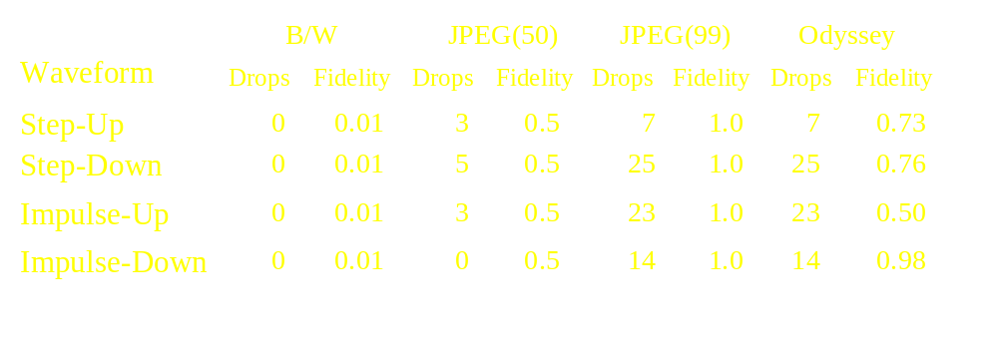
Results
Effect of adaptation ( performance and fidelity)

Slide 38
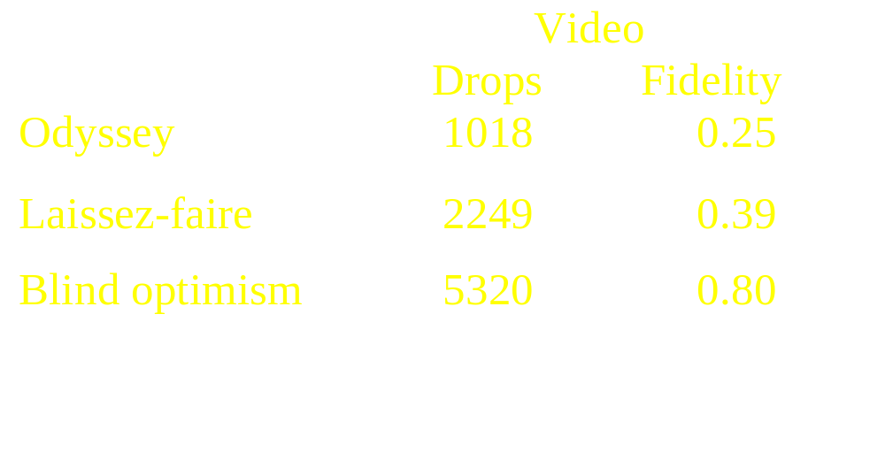
Results
Effect of centralized resource management

Slide 39
Conclusion and Future Work
Need for adaptation in mobile information access is widely accepted application-aware adaptation
They should apply resource management to other resources
Multiple fidelity levels for other applications should be supported (ex. Speech recognizer).
Systematic principles for adaptive mobile systems would be valuable.

Slide 40
References
J. J. Kistler and M. Satyanarayanan. Disconnected Operation in the Coda File System. ACM Transactions on Computer Systems, Vol. 10, No. 1, Feb. 1992, pp. 3-25.
M. Satyanarayanan et al. Coda: a Highly Available File System for a Distributed Workstation Environment. IEEE Transactions on Computers. Vol. 39, No. 4, April 1990, pp. 447-459.
B. D. Noble et al. Agile Application-Aware Adaptation for Mobility. In Proceedings of the 16th ACM Symposium on Operating System Principles. Oct. 1997.
B. D. Noble, M. Price, and M. Satyanarayanan. A Programming Interface for Application-aware Adaptation in Mobile Computing. In Proceedings of the 1995 USENIX Symposium on Mobile and Location-Independent Computing. April 1995.

